Slide 1

An Unsupervised Method for Terminology Extraction from Scientific Text
Wei Shao
Department of Information Management, Peking University
Notes:
Good night every one, I am Wei Shao, the presenter of this poster thanks for your attendance.I start.

Slide 2
Introduction
Finding Terminology from Texts with Unsupervised Methods
Lack of labelled data
Features Our Method Relies on
Features words: “propose”, “introduce”, “put forward”, “to solve”
POS sequence: “DT JJ NN”, “an integrated system”
Method Steps
Use initial patterns to get more patterns and pos sequences(cold start)
Extract terminologies from text with patterns and pos sequences
Notes:
Our work aims to find Terminology from Texts with Unsupervised Methods. Because most high performance methods are supervised methods. They hard to deal with data without annotation. For this purpose, we use two features of data. One is features words, like “propose”, “introduce”, “put forward”, “to solve”. Another is POS sequence: “DT JJ NN”, “an integrated system”. We use these features to match sentences and extract terminology entities from them.
More detail, our method has two steps. First step is to use initial patterns to get more patterns and pos sequences. called cold start. Second step is to extract terminologies from text with patterns and pos sequences.
Next, I will introduce the pattern.

Slide 3
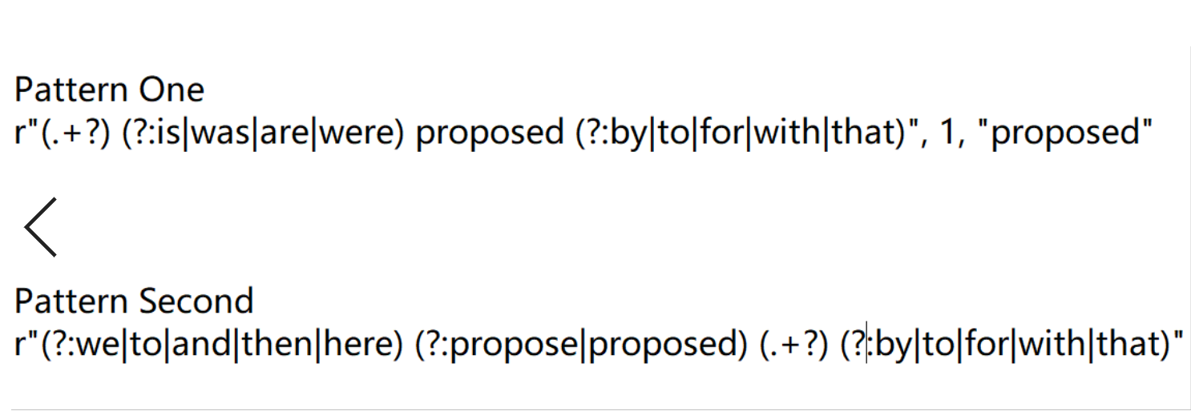
Pattern
Notes:
Here is an example of pattern. The pattern is a kind of regular expression which consists of feature words and terminolgoy match groups. When a sentence is matched, we can say this sentence includes terminology and can get it from match group.

Slide 4
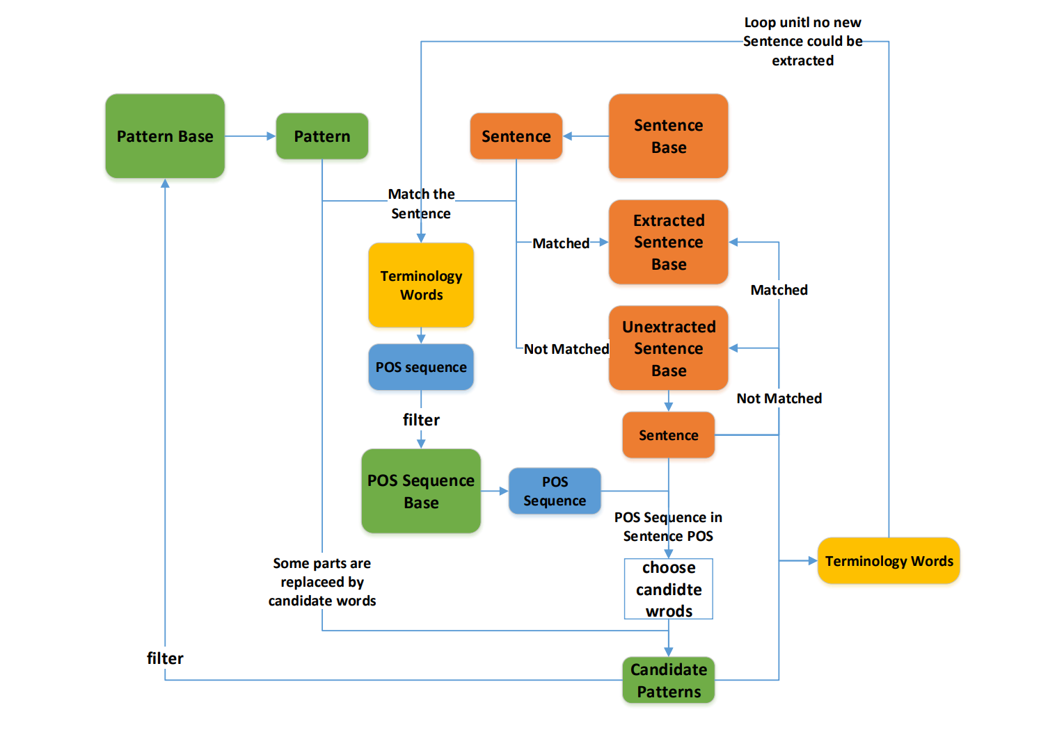
Cold Start
Notes:
Next, I will introduce the cold start step which is shown in this figure. The inputs are sentences and their POS sequences. First, we use each pattern from pattern base to match each sentence from sentence base. Matched sentence will be moved to extracted sentence base and we can obtain terminology words and their POS sequences. Otherwise, the sentence will be moved to unextracted sentence base. After getting terminology words and their POS sequences, we need to filter them to obtain more accurate results. The filtered POS sequences are moved to POS Sequence Base. Then, for each POS sequences from POS sequence base, it is used to find if the sentence POS sequence in unextracted sentence base contains itself. If sentence POS sequence contains, we can choose the candidate words from matched sentence for generation of new patterns. After new patterns are generated, we use them to match sentences in unextracted sentence base and new terminology words are obtained. Then we can choose and move suitable patterns to pattern base. For new terminology words, they replace the initial terminology words to participate in the extraction loop until no new sentence could be extracted.

Slide 5
Results and Future Work
Results
Get 146902 terminologies from 55000 sentences
Achieve 0.64 accuracy on test data (1000 sentences) via human evaluation
Future Work
Test our method on standard datasets
Compare it with some baselines.
Notes:
Finally, here are our results In the future, we will test our model on standard datasets and compare it with some baselines.

Slide 6
Thank you!
Notes:
Thanks

